Slide 1
Simulating F1 crashes till the first corner
Jordi wippert, kevin wilbrink

Slide 2
Content
Introduction
Methods
Results
Discussion

Slide 3
Introduction
Formula 1 crashes
Safety improvement
Monte Carlos simulation
Nagel-Schrekenberg
Notes:
Short introduction about what we researched and why.

Slide 4
Methods (I)
Four steps
Notes:
Explain method, first 2 steps using the image

Slide 5
Methods (II)
Notes:
Continued.. Next two steps

Slide 6
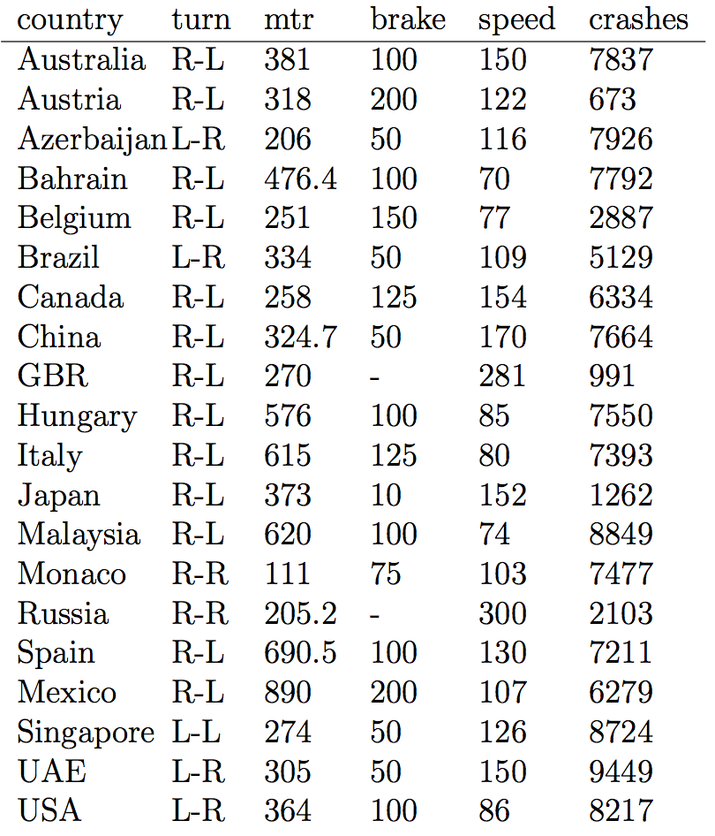
Results
10,000 runs for each track
200,000 runs in total
121,747 crashes
Notes:
A lot of crashes has been calculated, based on the table shown, the crashes are almost divided equally.

Slide 7
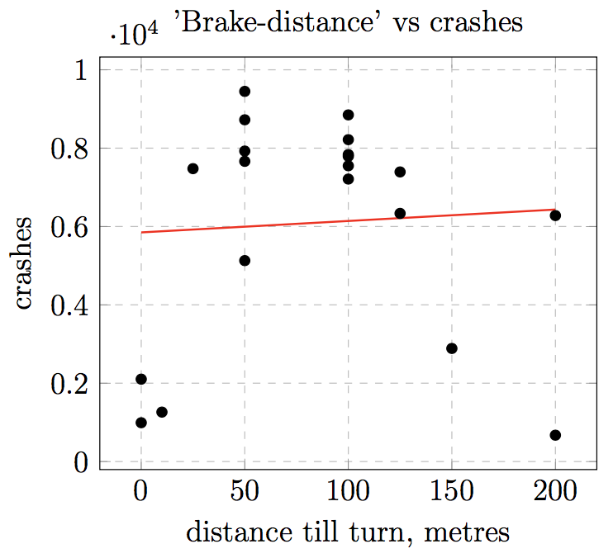
Results (II)
Notes:
Distance in metres before a turn that is used on average to brake before turn one to achieve the right speed, plotted against the amount of crashes.

Slide 8
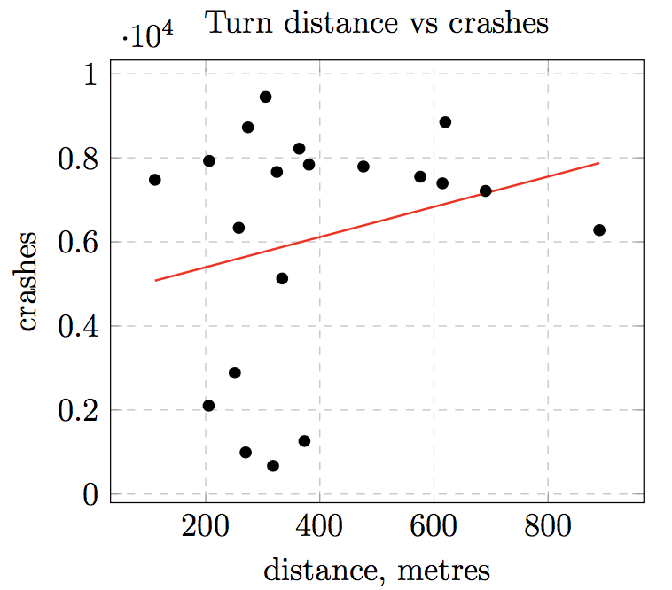
Results (III)
Notes:
Distance in metres calculated from start- line till first turn, plotted against the amount of crashes.

Slide 9
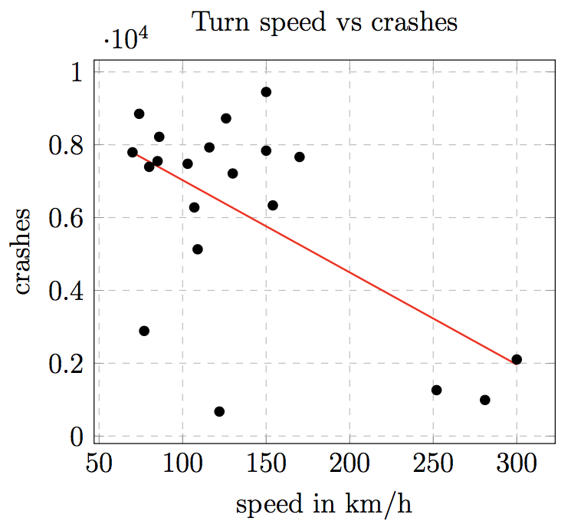
Results (IV)
Notes:
Maximum speed that should be driven in turn to achieve best result, plotted against crashes

Slide 10
Discussion & conclussion
All circuits 2017
Crashes divided equally
Real-world
No significant factor found
Row width
Notes:
Repeat the fact that crashes are somewhat devided equally over all the circuits in 2017. And that it’s inline with the real world. Our track width was 5, on some circuits it’s only 2 or 3 cars. So talk about this and about futher research. Improve the simulation and try to get more information? Oh and perhaps tell that we didn’t find a signifcant factor?

